Slide 1
Data Mining & Exploration
Derek Osik

Slide 2
Algorithm
AdaBound:
-Adam variant
- Employs dynamic bounds on learning rates
- Gradual and smooth transition to SGD (stochastic gradient descent)
- “As fast as Adam and as good as SGD”

Slide 3
Field
Finance
Predict the movement of TSLA stock
Follow-up on last semester’s project future works
Adjusted optimization algorithm
To optimize result (recent studies show “Adam” generalizes poorly sometimes)

Slide 4
Input Features
High - Low
Close - Open
3-Day MA
10-Day MA
30-Day MA
5-Day STD
Relative Strength Index (RSI)
Williams% Regression

Slide 5
Predict Movement of Stock Price
ANN Predicts Movement
Model returns “True” if stock
Model returns “False” if stock

Slide 6
Strategy Based on Prediction
If “True”, Long Position Strategy (Buy Stock)
If “False”, Short Position Strategy (Short Stock)
Strategy Returns Mapped Against Market Returns

Slide 7
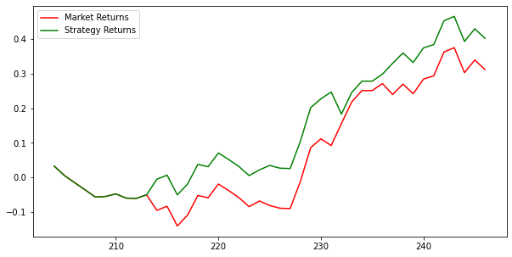
Accuracy of Predictive Model (Adam’s Optimizer)

Slide 8
Accuracy of Predictive Model (AdaBound Optimizer)
To Be Determined…...

Slide 9
Future Works
If “AdaBound” algorithm produces more accurate results;
Replicate for an entire portfolio

